Slide 1
Implementation of HPC for Music Genres Classification for music recommendation systems DSC 520-01: High Perform Scientific Compute NIKHILESH NARKHEDE (02196141)

Slide 2

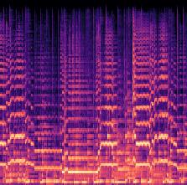
Problem Statement
Music genres: Build a DL model to classify music into the top 10 genres.
Audio Data Time series data.
If we go with traditional time series architecture like RNN, the LSTM model turns out to be bulky and faces problems like vanishing gradient.
But we can convert Audio data in image format using a spectrogram with a library like Librosa.
Its representation of the spectrum of frequency in sound recording as they vary over time.
Dark Area: Low-intensity frequency.
Orange and yellow Areas: High intensities frequency.
Spectrogram Creator
https://academo.org/demos/spectrum-analyzer/ Librosa

Slide 3
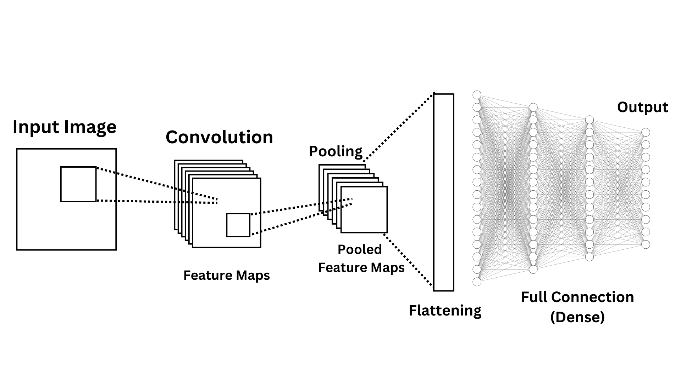
Architecture
Audio Data
Spectrogram Creator
Spectrogram Image Data
80/20 Train/Test split
Load Data using Image Data Generator
I have implemented HPC
Preprocessing Data: using Librosa, ipyparallel.
Deep Learning model training: Multithreading in TensorFlow.
HPC implementation
Preprocessing Data : sub-genre(e.g. Rock) 100 songs ipyparallel 25 songs for each worker. | Deep Learning model training : OpenMP Inter-operation Intra-operation
Genres Classifications
Worker 1
Worker 2
Worker 3
Worker 4

Slide 4
What is ipyparallel?
Key Components:
Controller: Distributes tasks and maintains the state.
Engines: Execute tasks independently.
Example Use Case:
Benefits:
A Python library that enables parallel task execution using multiple workers, ideal for distributed computing.
Parallel processing of audio files into spectrogram images to reduce computation time.
Improves efficiency, scales to multi-core systems, and integrates seamlessly with Python and Jupyter.
ipyparallel for Distributed Computing

Slide 5
OpenMP
OpenMP optimizes CPU-based computations by distributing work across multiple cores. Usage in this Model: Convolution layers (Conv2D) and matrix operations in fully connected layers (Dense) are parallelized. OpenMP ensures that operations like matrix multiplications for the filters in the convolution layers and the weight updates in the dense layers are executed across multiple CPU threads.
Inter-Operation Parallelism
Manages parallel execution across different operations in the computational graph.
Intra-Operation Parallelism
Optimizes parallelism within a single operation.
Each Conv2D operation (a matrix multiplication between input data and convolution filters) is broken into smaller tasks. Pooling and activation computations (like ReLU) for large feature maps are divided among threads.
Key Benefits
Improved efficiency and reduced execution time.
Scalability across multi-core systems.
Better utilization of computational resources.
If two Conv2D layers are computationally independent (e.g., during forward propagation), TensorFlow can process them concurrently. Pooling layers and dropout calculations can also be executed in parallel with certain independent layers.
Deep Learning Model Training Optimization

Slide 6
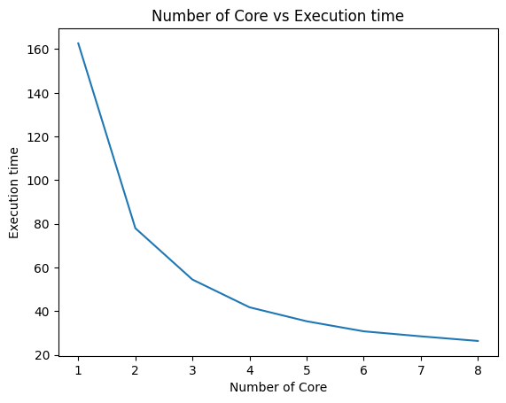
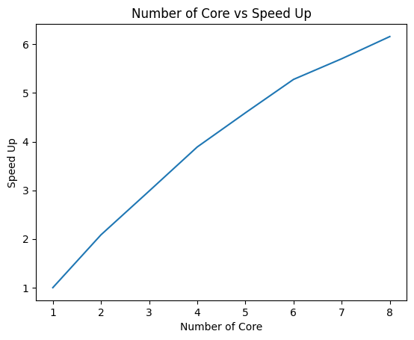
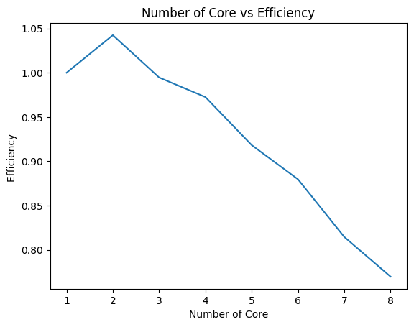
Result (Preprocessing)
Number of core vs Execution time | Number of core vs Speed-up | Number of core vs Efficiency

Slide 7
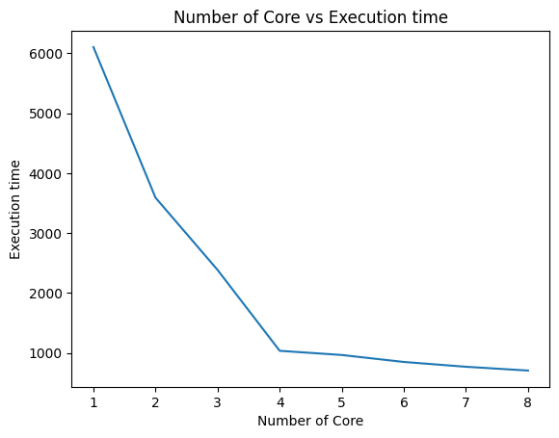
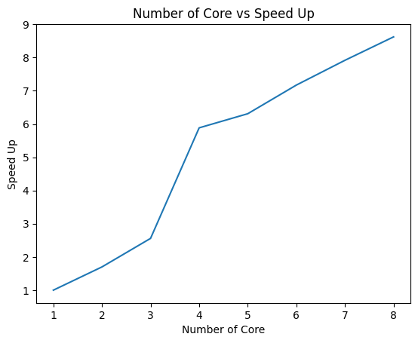
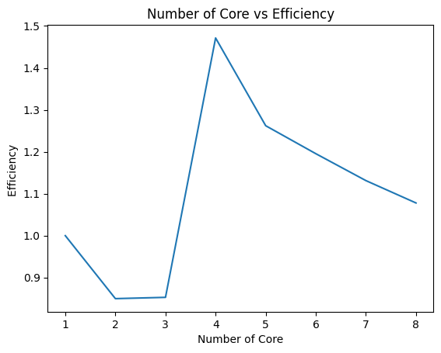
Result (DL Model Training)
Number of core vs Execution time | Number of core vs Speed-up | Number of core vs Efficiency

Slide 8
Conclusion
Preprocessing Data:
2 workers are most preferable in this context if efficiency is given more weight
4 workers are most preferable in this context if execution time is given more weight
Deep Learning Model Training:
4 Multithreading (Worker) is most preferable in this context in terms of both execution time and efficiency.

